Slide 1
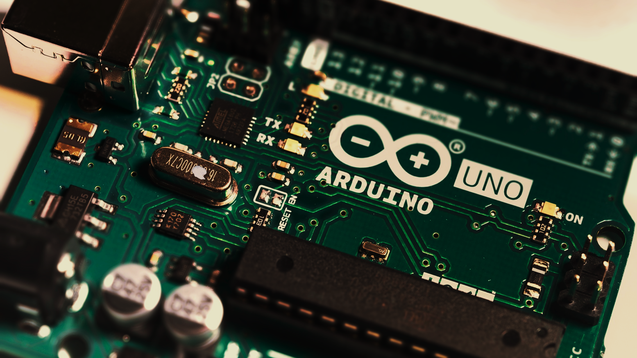
Arduino workshop
WEBER LIU
05-03-2019

Slide 2
Why are we using Arduinos?
Physiology research has always been dependent on developing and using tools/electronics!
X-lab tools are plug-and-play
If we needed to make our own tools, we wouldn’t be able to!
Arduinos give us a new level of control in designing our own tools
Bespoke individual solutions to problems
Learn how to create and implement small electronic devices
Learn how to program
We hope that after this lesson you will be more interested in electronics and programming

Slide 3
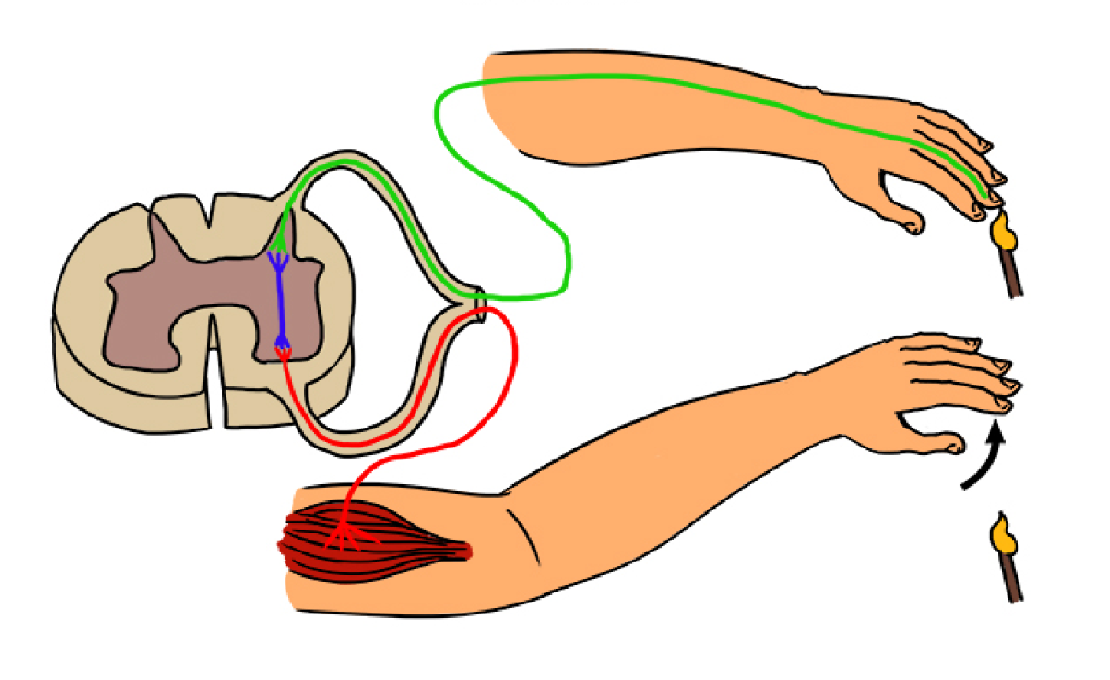
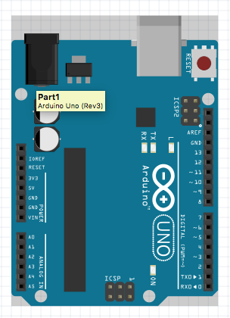
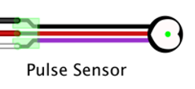
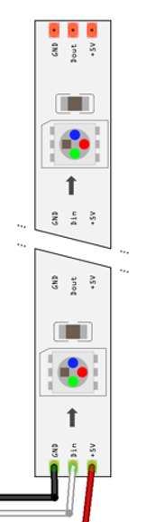
What’s an Arduino?
Consider how our brain works
Receptor (sensor) sends information in
Brain processes information
Effector performs function
Compare to how an Arduino circuit works
Arduino acts as the information processor
Pulse sensor acts as receptor
LEDs act as effector
Image from: http://mammothmemory.net/biology/coordination-and-response/nerves/three-types-of-neurone.html

Slide 4
Step 1a: Getting started
Collect Arduino sandwich bag from front – contains:
Arduino Uno board
Breadboard
USB cable (to connect w/ PC)
Pulsimeter
10 pixel neopixels strip
Short ‘jumper’ cable

Slide 5
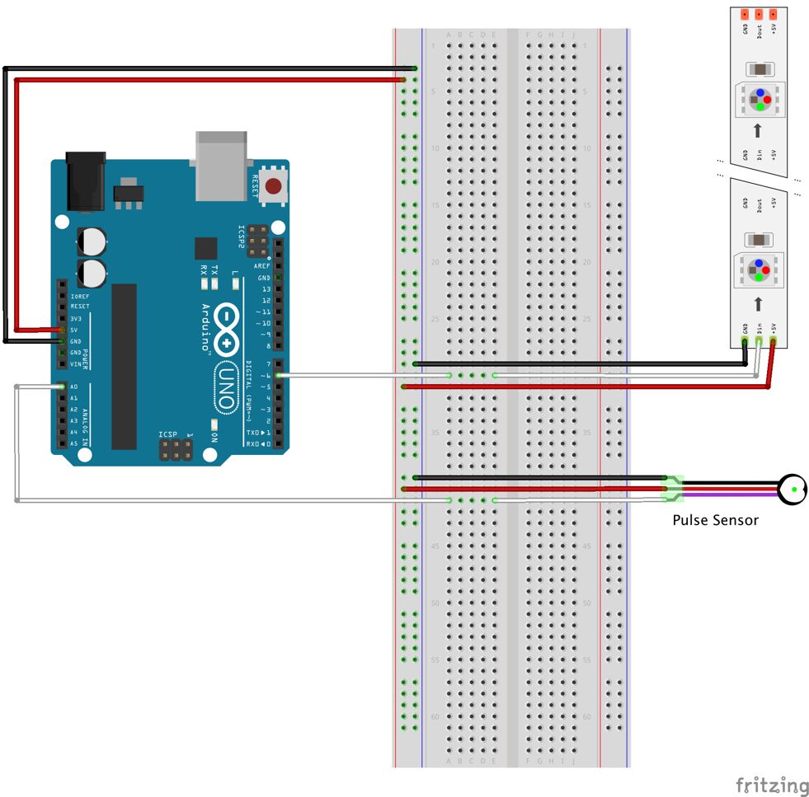
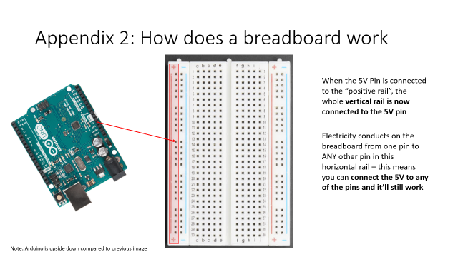
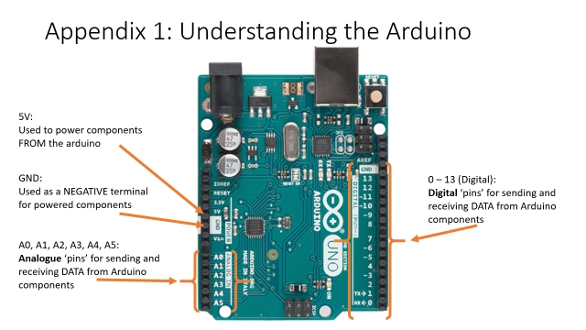
Step 1b: Wiring your Arduino
WTF is going on?

Slide 6
Step 1b: Wiring your Arduino
WTF is going on?
The 5V and GND pins are powering the positive and negative rails respectively
The A0 pin is connected to the horizontal strip with the DATA PIN on the pulse sensor
The Digital 6 pin is connected to the horizontal strip with the DATA PIN on the ped

Slide 7
2. Arduino details
Arduino code
const int analogInPin = A0;
int sensorValue = 0;
void setup() {
Serial.begin(9600);
}
void loop() {
sensorValue = analogRead(analogInPin);
Serial.println(sensorValue);
delay(100);
}
Pseudocode
“There’s an analogue sensor attached to pin A0”
“Whatever the sensor’s saying, put it in the variable ‘sensorValue’”
“Before you begin ANYTHING, make sure you’re sending any info from the sensor to the computer at 9600bps”
“Repeat the following commands:
Read in the value from the analogInPin (pin A0) and save it into the variable ‘sensorValue’
Send the variable ‘sensorValue’ over to the computer via the ‘Serial’
Wait 100ms before repeating
“

Slide 8
2. Arduino details (more detail)
Arduino code
const int analogInPin = A0;
int sensorValue = 0;
void setup() {
Serial.begin(9600);
}
void loop() {
sensorValue = analogRead(analogInPin);
Serial.println(sensorValue);
…
delay(100);
}
Pseudocode
“There’s an analogue sensor attached to pin A0”
“Whatever the sensor’s saying, put it in the variable ‘sensorValue’”
“Before you begin ANYTHING, make sure you’re sending any info from the sensor to the computer at 9600bps”
“Repeat the following commands:
Read in the value from the analogInPin (pin A0) and save it into the variable ‘sensorValue’
Send the variable ‘sensorValue’ over to the computer via the ‘Serial’ … = perform a calculation on the ‘sensorValue’ and use the calculated value to light up a neopixels strip
Wait 100ms before repeating
“

Slide 9

2. Arduino details (more detail)
Arduino code
const int analogInPin = A0;
int sensorValue = 0;
void setup() {
Serial.begin(9600);
}
void loop() {
sensorValue = analogRead(analogInPin);
Serial.println(sensorValue);
…
delay(100);
}
Pseudocode
“There’s an analogue sensor attached to pin A0”
“Whatever the sensor’s saying, put it in the variable ‘sensorValue’”
“Before you begin ANYTHING, make sure you’re sending any info from the sensor to the computer at 9600bps”
“Repeat the following commands:
Read in the value from the analogInPin (pin A0) and save it into the variable ‘sensorValue’
Send the variable ‘sensorValue’ over to the computer via the ‘Serial’ … = perform a calculation on the ‘sensorValue’ and use the calculated value to light up a neopixels strip
Wait 100ms before repeating
“
We can actually write out own Arduino code and make it do whatever we want, so long as we:
Have a ‘sensor’ component
+/- having an ‘effector’ component
Other available sensors we have here are:
ECG
Thermister
EMG
GSR
Other sensors (that need code written) include
Accelerometer
Polar heart rate monitor

Slide 10

What Arduino code can do
The Vivid project (collaboration between RAMUS and University of Sydney SoMs – lead by Prof. Philip Poronnik) used an Arduino to power a few of its components
I also accidentally fried that Arduino because I had no idea what I was doing
Image source: https://www.ramus.com.au/work/many-hands-make-light-work/

Slide 11
3. CoolTerm – recording serial inputs
‘SensorValue’ was sent through the Serial – the particular serial it was sent through is the Universal Serial Bus (USB port)
To use the data, we need to record this data!
Steps:
Get a laptop from the back and open ‘CoolTerm’
Open start menu
Type in ‘software center’
Run CoolTerm
OR
Download CoolTerm onto your own computer at http://freeware.the-meiers.org
If nothing seems to be working…
Options > port > COM-X (test COMs until it works…)

Slide 12
4. Recording serial data on CoolTerm
To record data:
Click ‘connect’
Connection > Capture to Textfile > Start
Name the text file [SID].txt and save it on your desktop
To stop recording data:
Connection > Capture to Textfile > Stop
The text file you captured will have a series of numbers on a different line – this is the raw sensor data
Question: what range does your raw sensor data appear to fall between?

Slide 13
5. Graphing your data in excel
(Let’s do it in person)
Tasks to complete before you leave – collect data in a single recording session:
1 minute resting as a baseline
1 minute with physical activity (Squats, running on spot)
1 minute resting for recovery
Repeat 3 times (if time permits)
Graph your results in excel

Slide 14
End of workshop

Slide 15
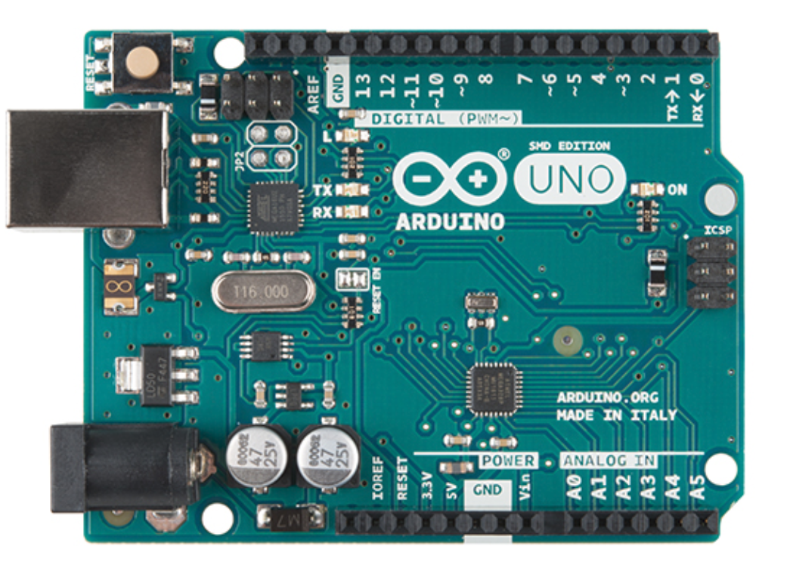
Appendix 1: Understanding the Arduino
5V:
Used to power components FROM the arduino
GND:
Used as a NEGATIVE terminal for powered components
0 – 13 (Digital):
Digital ‘pins’ for sending and receiving DATA from Arduino components
A0, A1, A2, A3, A4, A5:
Analogue ‘pins’ for sending and receiving DATA from Arduino components

Slide 16
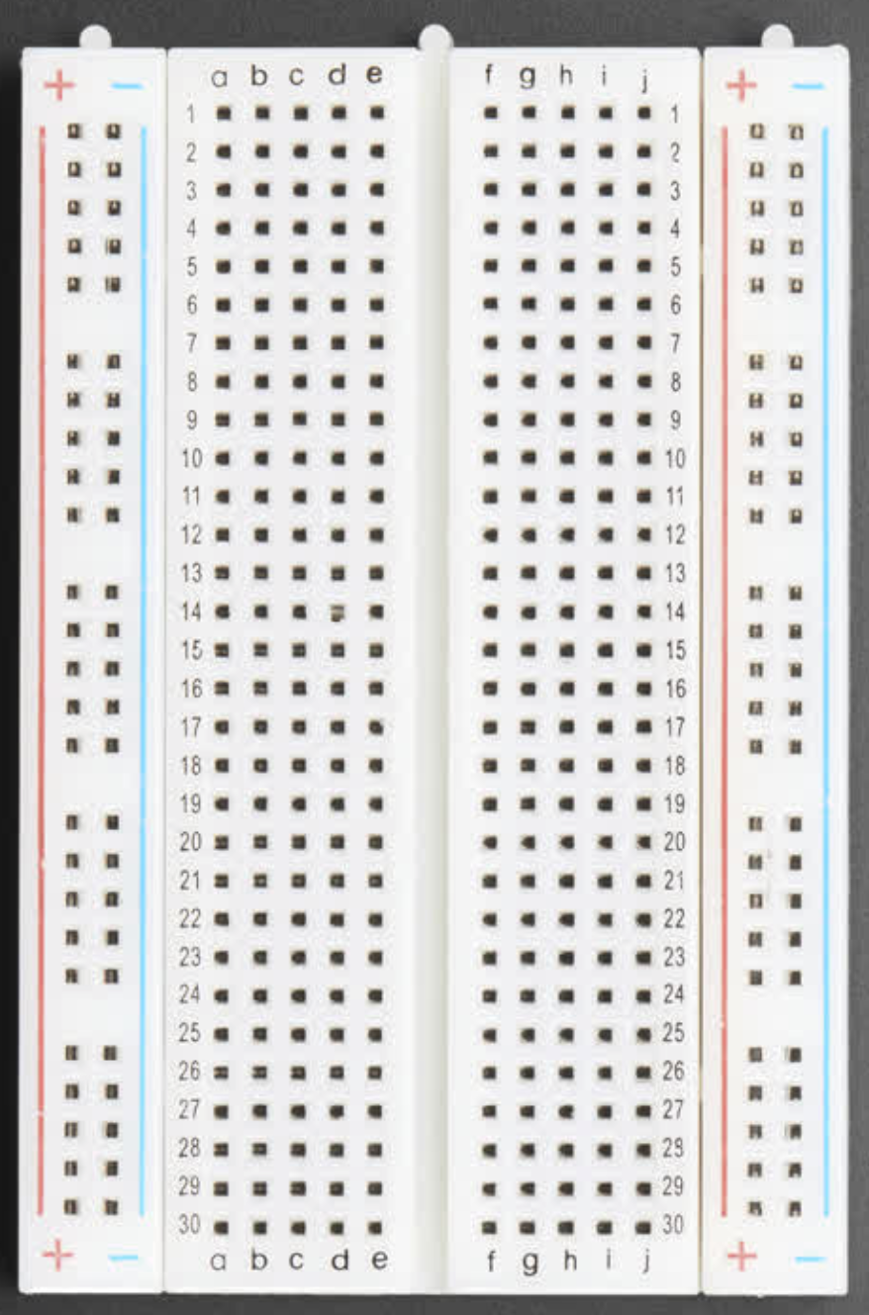
Appendix 2: How does a breadboard work
When the 5V Pin is connected to the “positive rail”, the whole vertical rail is now connected to the 5V pin
Electricity conducts on the breadboard from one pin to ANY other pin in this horizontal rail – this means you can connect the 5V to any of the pins and it’ll still work
Note: Arduino is upside down compared to previous image

Slide 17
Appendix 2: How does a breadboard work – the BUS STRIPS
When the GND pin is connected to the NEGATIVE rail, similarly the negative rail is COMPLETELY grounded
Again, due to the underlying design of the breadboard, you can connect the ground to ANY PIN on the negative rail and it’ll still work
Note: Arduino is upside down compared to previous image

Slide 18
Appendix 2: How does a breadboard work – the BUS STRIPS
The two halves of the breadboard are NOT electrically connected
The positive rail on the LHS isn’t connected to the positive rail on the RHS and vice versa
Columns ABCDE aren’t connected to FGHIJ either
Note: Arduino is upside down compared to previous image

Slide 19
Appendix 2: How does a breadboard work – the TERMINAL STRIPS
For each of the middle rows, they are electrically connected horizontally
i.e. if pin A0 is connected to row 9, effectively ALL pins in row 9 are connected to A0
Obviously remember: columns ABCDE aren’t connected to columns FGHIJ
Note: Arduino is upside down compared to previous image

Slide 20
Appendix 2: How does a breadboard work – the TERMINAL STRIPS
For each of the middle rows, they are electrically connected horizontally
i.e. if pin A0 is connected to row 9, effectively ALL pins in row 9 are connected to A0
Obviously remember: columns ABCDE aren’t connected to columns FGHIJ
Note: Arduino is upside down compared to previous image

Slide 21
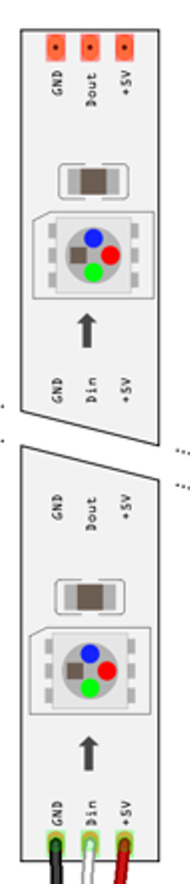
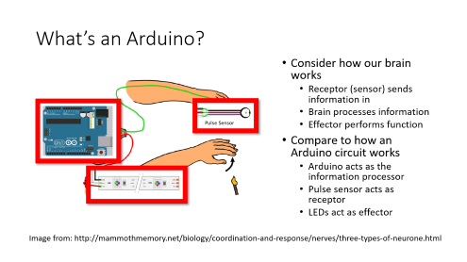
Appendix 2: How does a breadboard work – connecting COMPONENTS
GND on the component ALWAYS connects to the negative terminal
+5V on the component ALWAYS connects to the positive terminal
The Din (Data in) pin ALWAYS connects (via a horizonal terminal) to a data (Analog or Digital) pin
Note: Arduino is upside down compared to previous image

